Slide 1
Cornerstone City Church Peninsula Plus Community Hoo Are Ya
27-08-2023

Slide 2
Open The Eyes of My Heart
CCLI Song # 2298355
Paul Baloche
© 1997 Integrity's Hosanna! Music (Admin. by Integrity Music Ltd)
For use solely with the SongSelect® Terms of Use. All rights reserved. www.ccli.com
CCLI Licence No. 33265

Slide 3
1/3
Open the eyes of my heart Lord
Open the eyes of my heart
I want to see You
I want to see You

Slide 4
2/3
To see You high and lifted up
Shining in the light of Your glory
Pour out Your power and love
As we sing holy holy holy

Slide 5
3/3
Holy holy holy
Holy holy holy
Holy holy holy
I want to see You

Slide 6
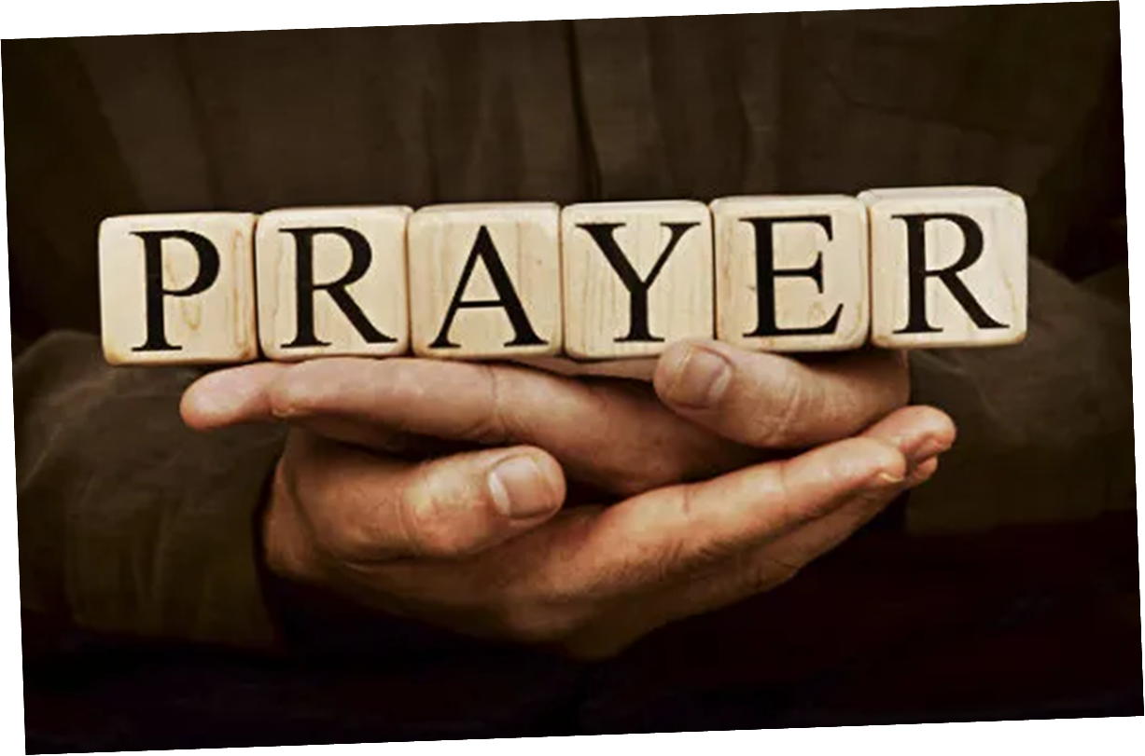

Slide 7
Did You Feel The Mountains Tremble
CCLI Song # 1097028
Martin Smith
© 1994 Curious? Music UK
For use solely with the SongSelect® Terms of Use. All rights reserved. www.ccli.com
CCLI License # 33265

Slide 8
1/6
Did you feel the mountains tremble
Did you hear the oceans roar
When the people rose to sing of
Jesus Christ the risen One

Slide 9
2/6
Did you feel the people tremble
Did you hear the singers roar
When the lost began to sing of
Jesus Christ the saving One

Slide 10
3/6
And we can see that God You're moving
A mighty river through the nations
And young and old will turn to Jesus
Fling wide you heavenly gates
Prepare the way of the risen Lord

Slide 11
4/6
Open up the doors and let the music play
Let the streets resound with singing
Songs that bring Your hope
Songs that bring Your joy
Dancers who dance upon injustice

Slide 12
5/6
Do you feel the darkness tremble
When all the saints join in one song
And all the streams flow as one river
To wash away our brokenness

Slide 13
6/6
And here we see that God You're moving
A time of jubilee is coming
When young and old return to Jesus
Fling wide you heavenly gates
Prepare the way of the risen Lord

Slide 15
The Lion And The Lamb
CCLI Song # 7038281
Brenton Brown | Brian Johnson | Leeland Mooring
© 2015 Meaux Mercy (Admin. by Capitol CMG Publishing)
The Devil Is A Liar! Publishing (Admin. by Capitol CMG Publishing)
Thankyou Music (Admin. by Integrity Music)
Bethel Music Publishing (Admin. by Song Solutions)
For use solely with the SongSelect® Terms of Use. All rights reserved. www.ccli.com
CCLI Licence No. 33265

Slide 16
1/6
He's coming on the clouds Kings and kingdoms will bow down And every chain will break As broken hearts declare His praise For who can stop the Lord Almighty

Slide 17
2/6
Our God is the Lion, the Lion of Judah He's roaring with power And fighting our battles And every knee will bow before Him Our God is the Lamb, the Lamb that was slain For the sins of the world His blood breaks the chains And every knee will bow before the Lion and the Lamb Every knee will bow before Him

Slide 18
3/6
So open up the gates Make way before the King of kings The God who comes to save Is here to set the captives free For who can stop the Lord Almighty

Slide 19
4/6
Our God is the Lion, the Lion of Judah He's roaring with power And fighting our battles And every knee will bow before Him Our God is the Lamb, the Lamb that was slain For the sins of the world His blood breaks the chains And every knee will bow before the Lion and the Lamb Every knee will bow before Him

Slide 20
5/6
Who can stop the Lord Almighty Who can stop the Lord (Almighty)

Slide 21
6/6
Our God is the Lion, the Lion of Judah He's roaring with power And fighting our battles And every knee will bow before Him Our God is the Lamb, the Lamb that was slain For the sins of the world His blood breaks the chains And every knee will bow before the Lion and the Lamb Every knee will bow before Him

Slide 23
King of Kings
CCLI Song # 7127647
Brooke Ligertwood | Jason Ingram | Scott Ligertwood
© 2019 Fellow Ships Music (Admin. by Essential Music Publishing LLC)
So Essential Tunes (Admin. by Essential Music Publishing LLC)
Hillsong Music Publishing Australia (Admin. by Hillsong Music Publishing UK)
For use solely with the SongSelect® Terms of Use. All rights reserved. www.ccli.com
CCLI Licence No. 33265

Slide 24
1/9
In the darkness we were waiting
Without hope without light
Till from Heaven You came running
There was mercy in Your eyes

Slide 25
2/9
To fulfil the law and prophets
To a virgin came the Word
From a throne of endless glory
To a cradle in the dirt

Slide 26
3/9
Praise the Father
Praise the Son
Praise the Spirit three in one
God of Glory
Majesty
Praise forever to the King of kings

Slide 27
4/9
To reveal the kingdom coming
And to reconcile the lost
To redeem the whole creation
You did not despise the cros

Slide 28
5/9
For even in Your suffering
You saw to the other side
Knowing this was our salvation
Jesus for our sake You died

Slide 29
6/9
And the morning that You rose
All of heaven held its breath
Till that stone was moved for good
For the Lamb had conquered death

Slide 30
7/9
And the dead rose from their tombs
And the angels stood in awe
For the souls of all who'd come
To the Father are restored

Slide 31
8/9
And the Church of Christ was born
Then the Spirit lit the flame
Now this Gospel truth of old
Shall not kneel shall not faint

Slide 32
9/9
By His blood and in His Name
In His freedom I am free
For the love of Jesus Christ
Who has resurrected me

Slide 33
O Praise The Name (Anástasis)
CCLI Song # 7037787
Benjamin Hastings | Dean Ussher | Marty Sampson
© 2015 Hillsong Music Publishing Australia (Admin. by Hillsong Music Publishing UK)
For use solely with the SongSelect® Terms of Use. All rights reserved. www.ccli.com
CCLI Licence No. 33265

Slide 34
1/1
O praise the Name of the Lord our God
O praise His Name forevermore
For endless days we will sing Your praise
Oh Lord oh Lord our God

Slide 35


Slide 36


Slide 37
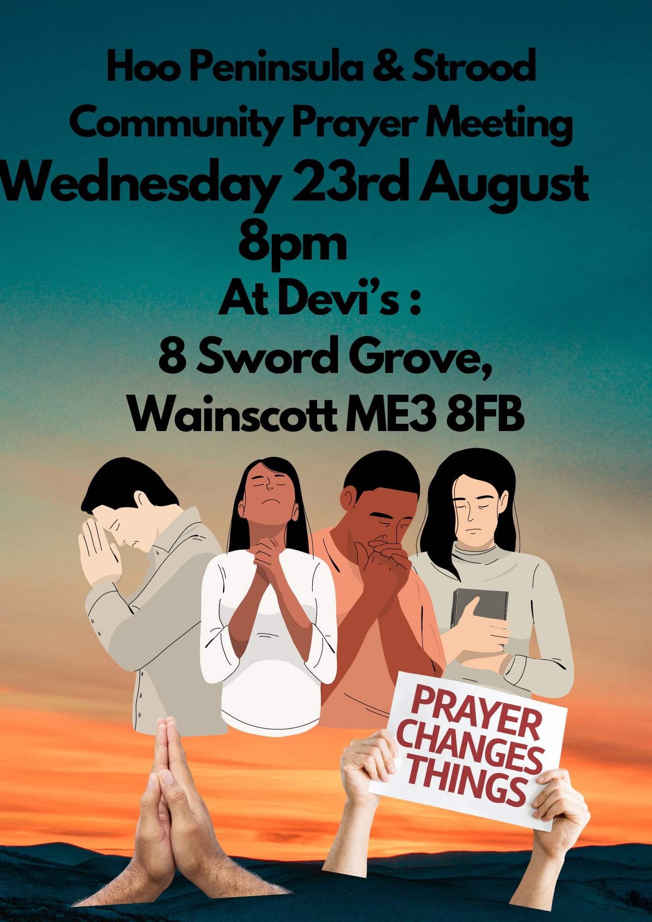

Slide 38


Slide 39


Slide 40
Amen!

